Slide 1
Toward persistent autonomous intervention in a subsea panel

Slide 2
Introduction
AUV(autonomous underwater vehicles)
Planning
Experiments and results

Slide 3
Introduction
1. Long-term autonomy is a primary goal of ongoing robotics research. (dynamic nature and inherent complexities)
2. Learning, Adaptation, Observation and Replanning project. (PANDORA目标是通过赋予AUV先进的能力来描述环境，然后行动，并在长时间运行中能根据需要调整计划而不需要人为干预)
3. Define a test scenario.
(mechatronics, image perception, localization, control, machine learning, and planning)

Slide 4
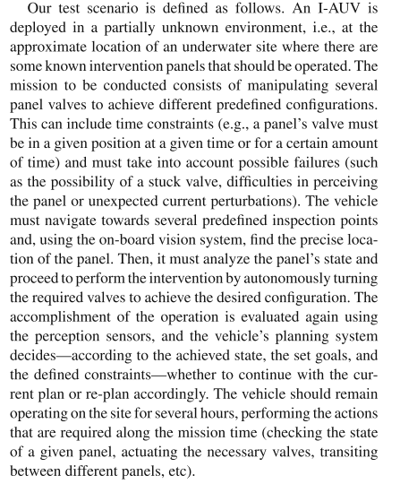


Slide 5
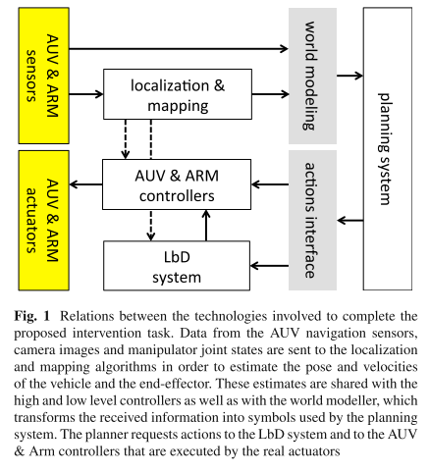

Slide 6
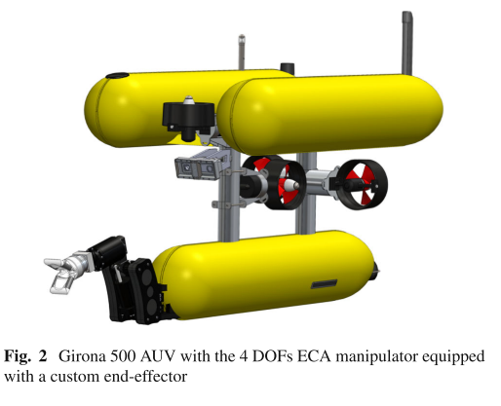
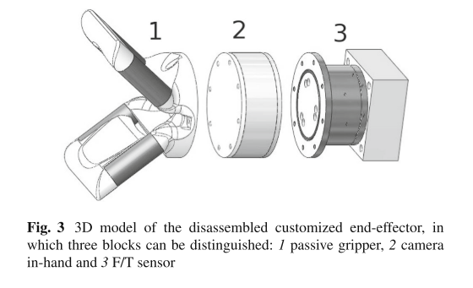
AUV
三个鱼雷形船体、一定数量的推进器、传感器（压力传感器、速度记录仪DVL、航向参考系统AHRS、GPS）、摄像头、机械臂、末端执行器。
1--抓手 2—摄像头 3—F/T 传感器

Slide 7
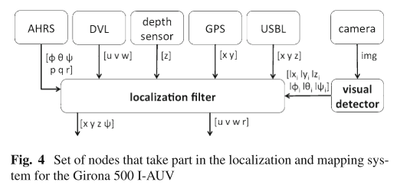
Sect.3 Localization and mapping
Present a low-computational cost SLAM system designed for real-time AUV operation.
① EKF localization filter（合并不同导航数据源）
② Vision-based template detection algorithm（检测和估计环境中已知物体的位置）

Slide 8
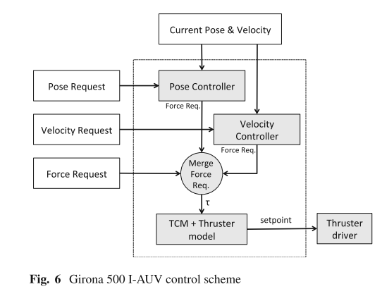
Sect.4 Control

Slide 9
Sect.5 Learning by demonstration
DMP（动态运动原语）uses the learned model to dynamically generate the commands required to perform the reproduction of the trajectory。
① Demonstration
② Learningthe DMP trajectory
③ Reproduction

Slide 10
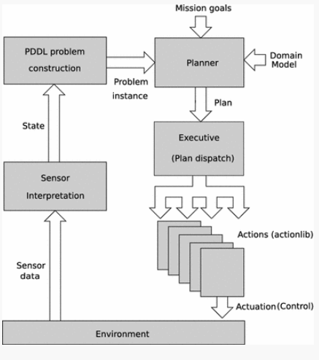
Planning

Slide 11
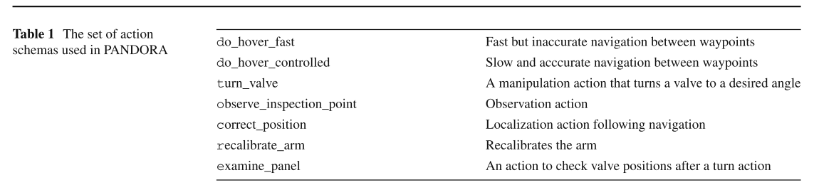

Slide 12
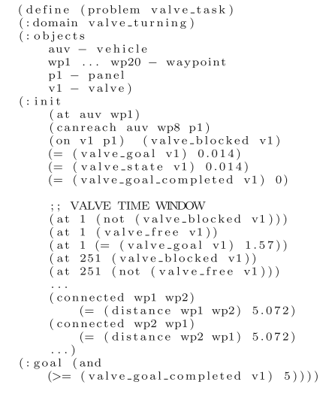
问题实例
Notes:
阀门转动任务的部分PDDL问题实例。该问题是从感知环境和任务指令动态构建的。检测阀板的存在和阀的角度，同时规定这些阀的所需角度。在这个问题中，有一个阀门v1，在任务的前251秒内必须转向1.57弧度

Slide 13
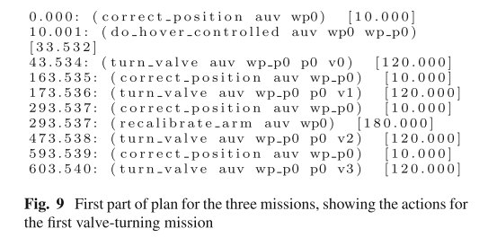

Slide 14
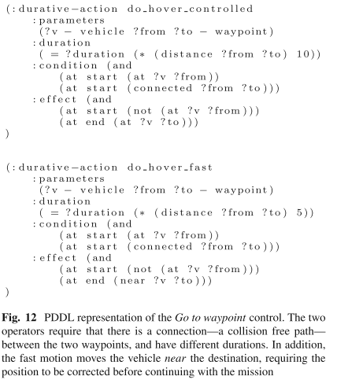
动作描述

Slide 15
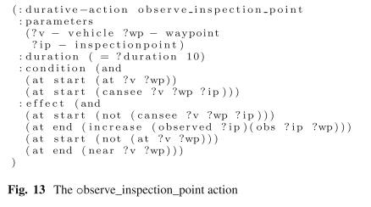

Slide 16
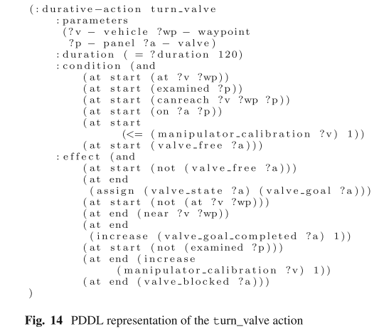

Slide 17
Turn action failure
Blocked Valve
Panel not in previously discovered place
Manipulator calibration problem
In these cases, the planner will attempt to find a solution—normally retrying the failed action or, in the worst case, aborting the whole mission.

Slide 18
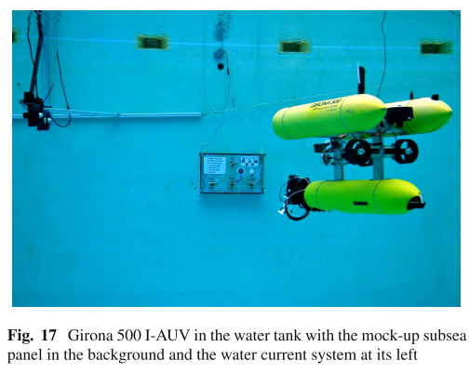
Experiments and results

